Slide 1
An Introduction to NN

Slide 2
NN - Neural Network
Future of computing
Puzzle
뉴렬넷쓰는이유
광범위한 문제영역 다룰수있다
복잡한 영역에서도 훌륭한 결과를 도출
결과를 설명 못한다, 모든 입력과 출력이 0과 1사이로 조작되어야한다

Slide 3
Human Brain
Ten billion neurons - connected to thousand other neurons - send energies - don’t react immediately
How to learning - adjusting the number and strength of these connections

Slide 4
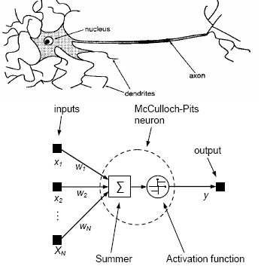
TLU (Threshold Login Units)
Aritficial neuron - input - weight - output - activation function

Slide 5
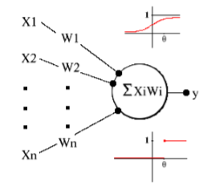
Ex> TLU
Weights = 1
Threshold = 1.5
Input <x1, x2> - output 1 : <0, 0> - 0 2 : <0, 1> - 0 3 : <1, 0> - 0 4 : <1, 1> - 1
Classfication { 0, 1 }

Slide 6
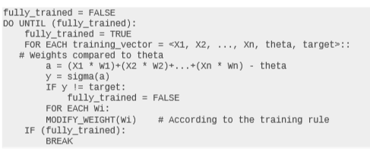
Ex> idealized learning algorithm

Slide 7
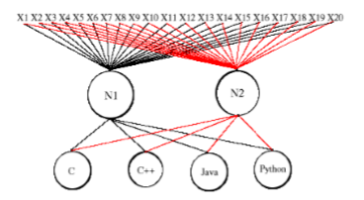
Ex> identifies the code's language (C, C++, Java, Python)

Slide 8
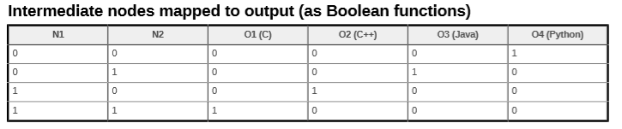
ex> identifies the code's language (C, C++, Java, Python)
N1: C or C++ = 1 / Java or Python = 0
N2: C or Java = 1 / C++ or Python =0

Slide 9
Training rule
Perceptron learning rule - (t – y) - learning rate

Slide 10
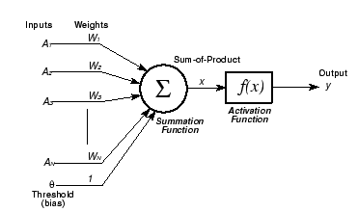
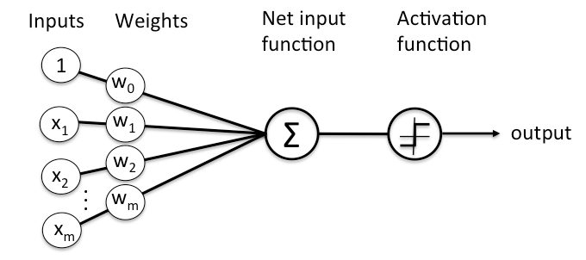
TLU (Threshold Login Units)

